Slide 1
Configuration for static multipath tests for data aided EQ
custom
BERT
interface
BERT
custom
clk/data
power
splitter
T/M RX
EQ +
demod
clk/data
channel 1
IF
clk/data
<10 mW @ 10.3125 Mbit/s
(vp = 27)
clk/data
preamble finder + phase ambiguity
clk/data
SOQPSK
TX
multipath
channel
noise
source
channel 1
clk/data
clk/data
QSX-RDMS
-RM2-Q-1100-X2
Spirint SR 5500
Wireless Channel Emulator
Fast Bit
FB0008
QSX VMR 110 00S 20 2D VP iNET
S/N 7452
Spec. An.
Agilent E4404B
ESA-E Series Spectrum Analyzer
Mini-circuits
ZB4PD-462W-S+

Slide 2
Channel settings
3-ray channel
ray 1 = 1∠0, delay = 0
ray 2 = 0.8∠θ, delay = 50 ns, θ = 180°, 150°, 120°
ray 3 = 0.1∠90°, delay = 155 ns

Slide 3
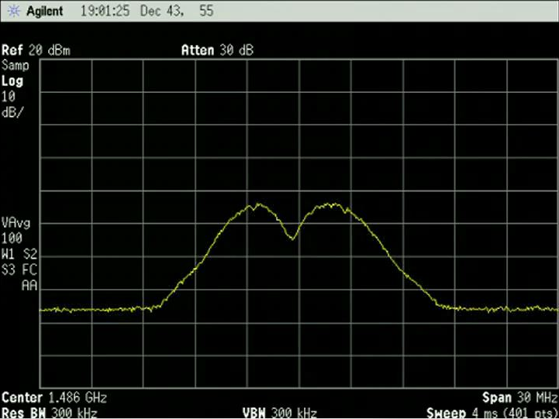
BYU Test 03 April 2017
Quasonix TX S/N 8449
3-ray channel
ray 1: 0 dB, θ = 0°, delay = 0 ns
ray 2: -1.5 dB, θ = 180°, delay = 50 ns
ray 3: -20 dB, θ = 90°, delay = 155 ns

Slide 4
BYU Test 27 March 2017
Quasonix TX S/N 7452
3-ray channel
ray 1: 0 dB, θ = 0°, delay = 0 ns
ray 2: -1.5 dB, θ = 180°, delay = 50 ns
ray 3: -20 dB, θ = 90°, delay = 155 ns

Slide 5
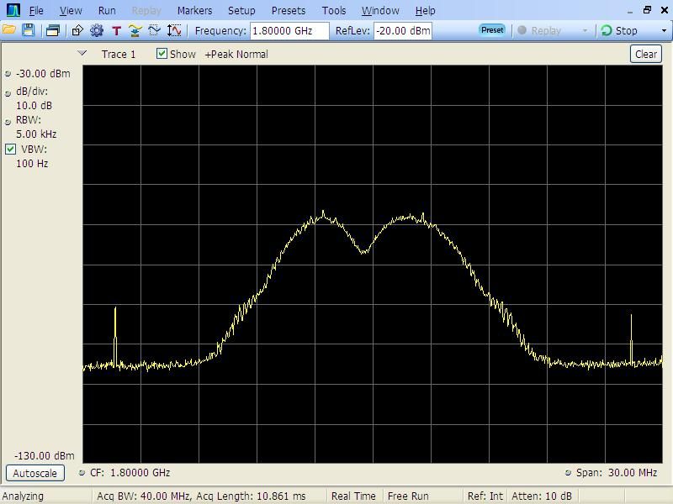
EAFB Test 27 July 2016
Quasonix TX S/N 7452
3-ray channel
ray 1: 0 dB, θ = 0°, delay = 0 ns
ray 2: -1.5 dB, θ = 180°, delay = 50 ns
ray 3: -20 dB, θ = 90°, delay = 155 ns

Slide 6
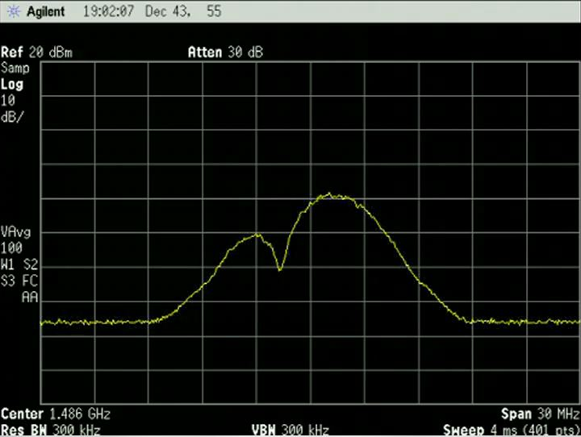
BYU Test 03 April 2017
Quasonix TX S/N 8449
3-ray channel
ray 1: 0 dB, θ = 0°, delay = 0 ns
ray 2: -1.5 dB, θ = 150°, delay = 50 ns
ray 3: -20 dB, θ = 90°, delay = 155 ns

Slide 7
BYU Test 27 March 2017
Quasonix TX S/N 7452
3-ray channel
ray 1: 0 dB, θ = 0°, delay = 0 ns
ray 2: -1.5 dB, θ = 150°, delay = 50 ns
ray 3: -20 dB, θ = 90°, delay = 155 ns

Slide 8
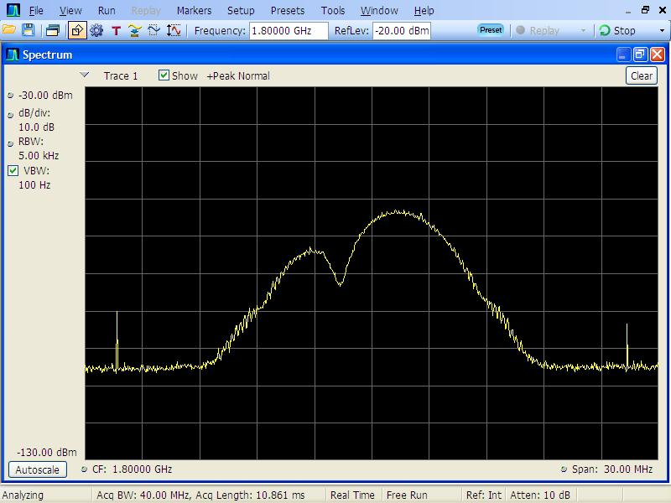
EAFB Test 27 July 2016
Quasonix TX S/N 7452
3-ray channel
ray 1: 0 dB, θ = 0°, delay = 0 ns
ray 2: -1.5 dB, θ = 150°, delay = 50 ns
ray 3: -20 dB, θ = 90°, delay = 155 ns

Slide 9
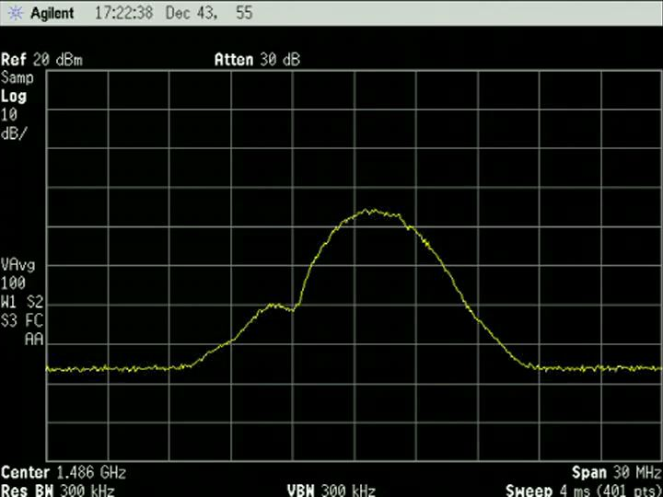
BYU Test 03 April 2017
Quasonix TX S/N 8449
3-ray channel
ray 1: 0 dB, θ = 0°, delay = 0 ns
ray 2: -1.5 dB, θ = 120°, delay = 50 ns
ray 3: -20 dB, θ = 90°, delay = 155 ns

Slide 10
BYU Test 27 March 2017
Quasonix TX S/N 7452
3-ray channel
ray 1: 0 dB, θ = 0°, delay = 0 ns
ray 2: -1.5 dB, θ = 120°, delay = 50 ns
ray 3: -20 dB, θ = 90°, delay = 155 ns

Slide 11

EAFB Test 27 July 2016
Quasonix TX S/N 7452
3-ray channel
ray 1: 0 dB, θ = 0°, delay = 0 ns
ray 2: -1.5 dB, θ = 120°, delay = 50 ns
ray 3: -20 dB, θ = 90°, delay = 155 ns

